Slide 1


Slide 2
Content:
Definition Digital Piracy.
Our project.
Quotations.
Reason for choosing this topic.
Conclusion.

Slide 3
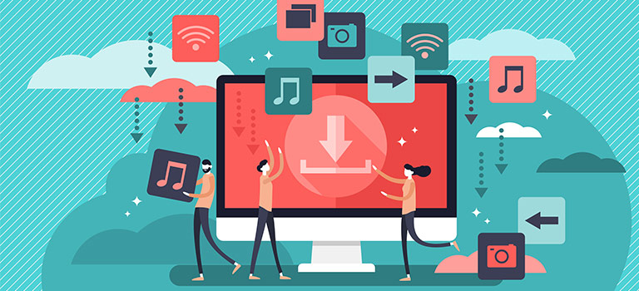
Digital Piracy

Slide 4
What is Digital Piracy:
Digital piracy refers to the illegal copying or distribution of copyrighted material via the Internet. It negatively affects the creative industries, including film, TV, publishing, music and gaming.
Digital piracy refers to the illegal act of duplicating, copying, or sharing a digital work without the permission of the copyright holder, a violation of copyright laws (Copyright Office of the United States 2008).
Piracy is known by a variety of names, including internet piracy, online piracy, and digital piracy, to name a few, but regardless of the name, piracy is the illegal copying of protected property that violates the owner's copyright.

Slide 5
Research:
It is $200million industry in only America.
There are 850 Piracy websites, and every year 50 more are including in 850.
Owners of these websites earn/took $70million from infected computers with malware

Slide 6
Example of Piracy:
Making unlawful copies of copyrighted
  music
  games
  software
  electronic books
  movies
  Songs
  as well as streaming that content without authorization are all examples of piracy.

Slide 7
How digital piracy works?
Copying: The first step in digital piracy is copying the original content. This can be done by ripping a DVD, downloading a digital file from the internet, or making a copy of software.
Distribution: Once the content has been copied, it is often distributed through file-sharing networks, peer-to-peer networks, or websites. This allows other users to access and download the content without paying for it.
Hacking: In some cases, digital pirates may use hacking techniques to gain access to restricted content, such as software or games that require a license key.

Slide 8
Modification: Digital pirates may also modify the original content, such as removing digital rights management (DRM) protection or adding their own branding or advertisements.
Sale: In some cases, digital pirates may sell pirated content, such as through online marketplaces or on physical media.

Slide 9
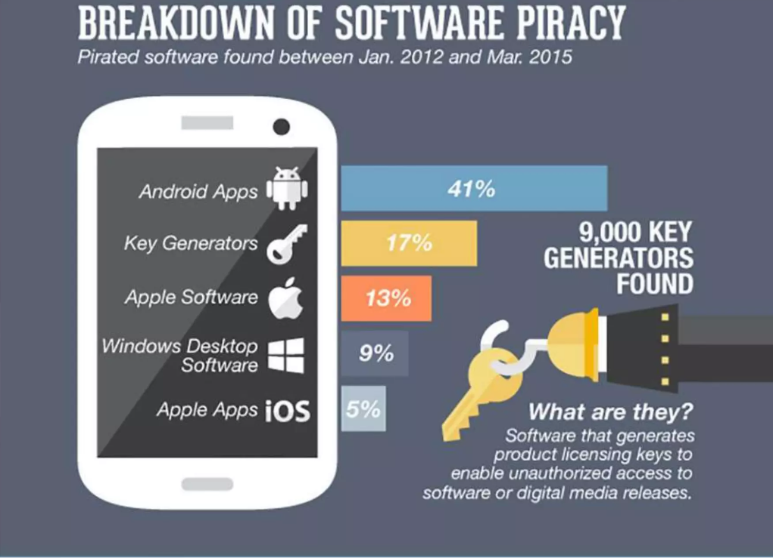

Slide 10
Major Types of Digital Piracy:
While digital piracy pertains to any type of digital medium, there are currently three primary media that receive considerable attention: music piracy (e.g., song recordings), video piracy (e.g., movies or television shows), and software piracy (e.g., computer programs or games).
the scope of digital piracy includes illegally reproducing or distributing physical copies of digital works, online digital piracy has placed the scope of this phenomenon on a global scale. Recent estimates indicate that online digital piracy has cost each respective industry billions of dollars in losses worldwide

Slide 11
Types of digital piracy:
Peer-to-Peer (P2P) Piracy: This is when users share files via a P2P network, such as BitTorrent, without the permission of the copyright owner.
Online Piracy: This includes the unauthorized streaming or downloading of copyrighted content, such as movies, TV shows, music, and software, from websites or file-sharing services.
Software Piracy: This is the illegal distribution and use of software, such as games, operating systems, and applications, without the permission of the copyright owner.

Slide 12
Counterfeiting: This is the unauthorized production and distribution of copyrighted works, such as DVDs and CDs, with the intent to deceive consumers.
Cracking: This refers to the unauthorized modification of software to remove copy protection, license keys, or other restrictions.
Keygenning: This is the creation and distribution of software key generators, which generate license keys for software, without the permission of the copyright owner.

Slide 13
Thought Behind Piracy:
In the mid 1970s, computer hobbyists began copying and distributing hardcopies of computer software and games. These hobbyists, who came to be known as hackers, subscribed to the philosophy that computer information should be shared and openly accessed.

Slide 14
Punishment of Song Piracy:
(FBI) Punishment for digital piracy can be quite severe. For example, civil penalties brought by recent RIAA lawsuits for music piracy can begin at $750 per song.
Criminal penalties for piracy can include prison sentences of up to five years as well as potential fines up to $250,000.

Slide 15
A Profitable Crime:
Piracy services generate revenue through various means, including:
Advertising: These sites may receive payment from advertisers based on the number of impressions or clicks.
Donations: Some piracy services may ask users to donate money in exchange for access to premium content or to support their site.
Subscription services: Users may be able to access high-quality versions of pirated content or gain access to “premium” content in exchange for a subscription fee.

Slide 16
Selling user data: Some piracy services may sell user data, such as browsing history or personal information, to third-party companies.
Affiliate marketing: Piracy services may generate revenue by referring users to the sites or products from online retailers.

Slide 17
Cyber-security Risks:
Research has shown that pirate sites present a distinct security risk for consumers.
Risks include:
Pirated contents used as traps to steal personal data, bank information or other sensitive information.
Unsafe payment methods, which can lead to credit card fraud or other financial scams.
Software updates (or lack of them) for products obtained through piracy can result in security vulnerabilities and other problems.

Slide 18
How to spot a pirate site
How do you identify a pirate service?
Be wary of any site offering a huge amount of content for a low price (or for free).
Many content providers offer only their own packages in the territories for which they have rights. So go to the company’s website and see what you can buy legitimately.
Check the prices as well – legitimate content will usually be more expensive than a pirate service, but you receive a quality, reliable service with good customer service to support you if you have problems.

Slide 19
How to deal with piracy?
Here are some of the most basic and effective ways to address the issue:
Trust your instincts. Check the online seller’s price against the estimated retail value of the software. If a price seems “too good to be true,” it probably is.
Make sure it’s authentic. Be suspicious of software products that do not include proof of authenticity such as original disks, manuals, licensing, services policies, and warranties.
Beware of backups. Avoid sellers offering to make backup copies. This is a clear indication the software is illegal.

Slide 20
Steer clear of compilations. Be wary of compilations of software titles from different publishers on a single disk or CD.
Get seller’s contact information. If you cannot contact the seller after making a purchase, you may have no recourse if the product turns out to be pirated. Make certain to get the seller’s address, if possible.
Keep Receipts. Printout a copy of your order number and sales confirmation and file them for your records. This information will help build your case if it is pirated and further action is needed.

Slide 21
Conclusion:
In conclusion, digital piracy involves the theft and sharing of digital content from other creators without their permission. It leads to the loss of millions of dollars each year from the content creators and their support systems. Also From the users who uses torrent network they earn 70million$ every year from infected computer. So it concludes that we should use original softwares.

Slide 22


